Slide 1
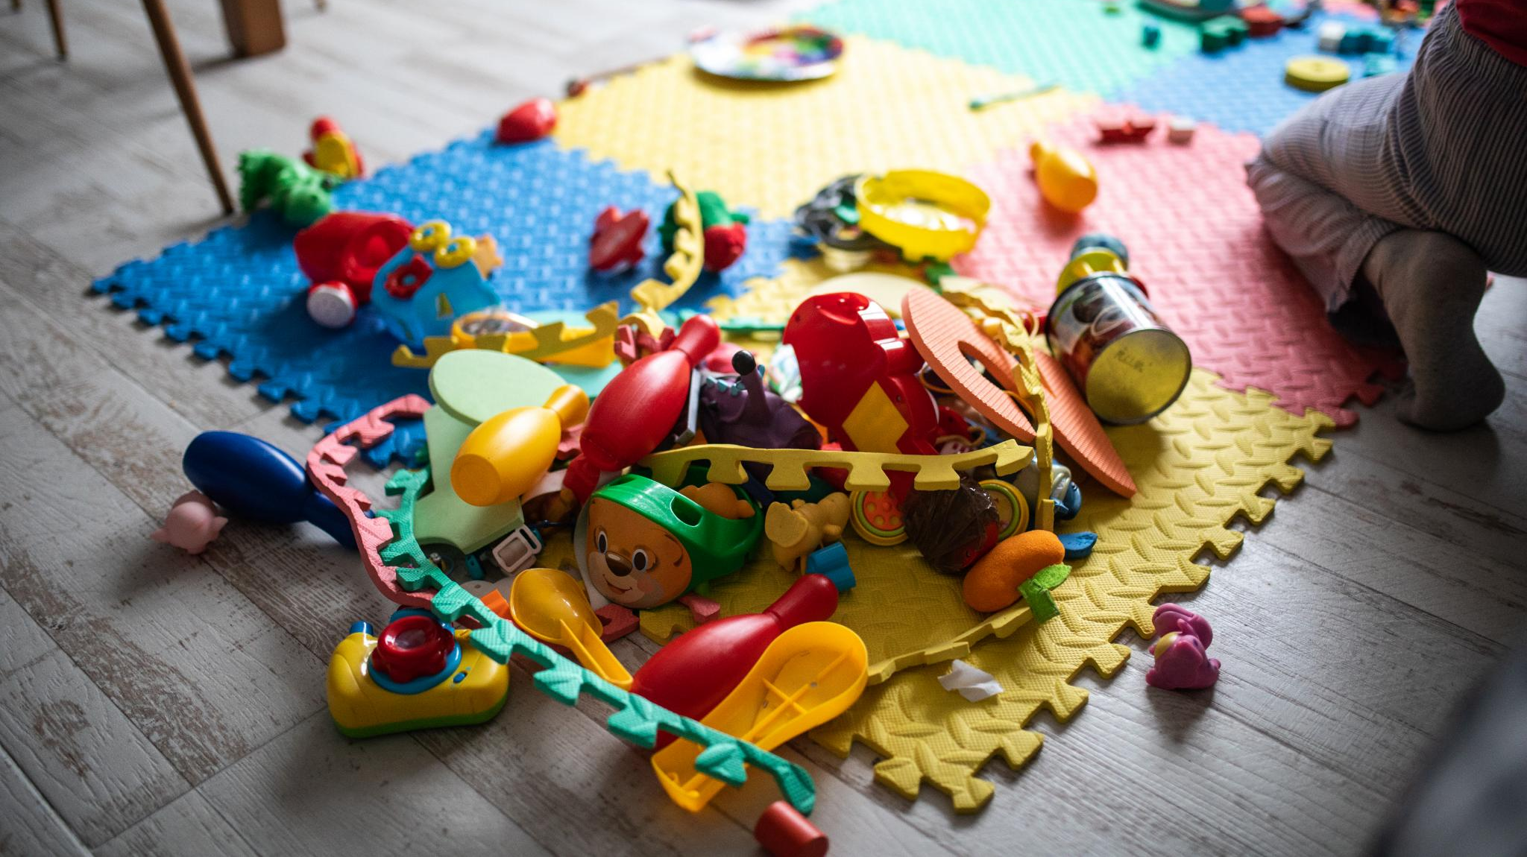
Using Sensory Bags in Primary Schools
Enhancing learning through tactile and sensory tools
Notes:
---

Slide 2
Introduction and Context
Notes:
Using Sensory Bags in Primary Schools

Slide 3

Using Sensory Bags in Primary Schools
Purpose of Sensory Bags
  Sensory bags support pupils with sensory processing and emotional regulation needs within inclusive classrooms effectively.
Preventative Use
  Sensory bags can be used preventatively to reduce dysregulation and help maintain pupils’ focus during learning tasks.
Supporting Re-regulation
  Sensory bags help pupils re-regulate emotions when dysregulation occurs, promoting better learning access and inclusion.
Staff Training Importance
  Training ensures staff understand sensory bags are supportive tools, not rewards or behaviour management devices.
Notes:
This presentation is designed for SENDCOs and teachers working in primary school settings and focuses on the purposeful use of sensory bags as part of inclusive classroom practice. Sensory bags are a practical and accessible strategy that can be embedded into everyday routines to support pupils with sensory processing differences, emotional regulation needs, attention difficulties, and wider SEND profiles. In the context of staff training, it is important to emphasise that sensory bags are not a reward or a behaviour management tool, but a proactive and supportive adjustment that enables pupils to access learning more effectively. The presentation will explore how sensory bags can be used preventatively to reduce dysregulation, how they can support focus and attention during learning tasks, and how they can help pupils to re-regulate when dysregulation occurs. By understanding the rationale behind sensory tools and how to implement them consistently and appropriately, staff can feel more confident in supporting pupils’ individual needs while maintaining high expectations for learning and inclusion across the classroom.

Slide 4
Understanding Sensory Bags
Notes:
What Are Sensory Bags?

Slide 5
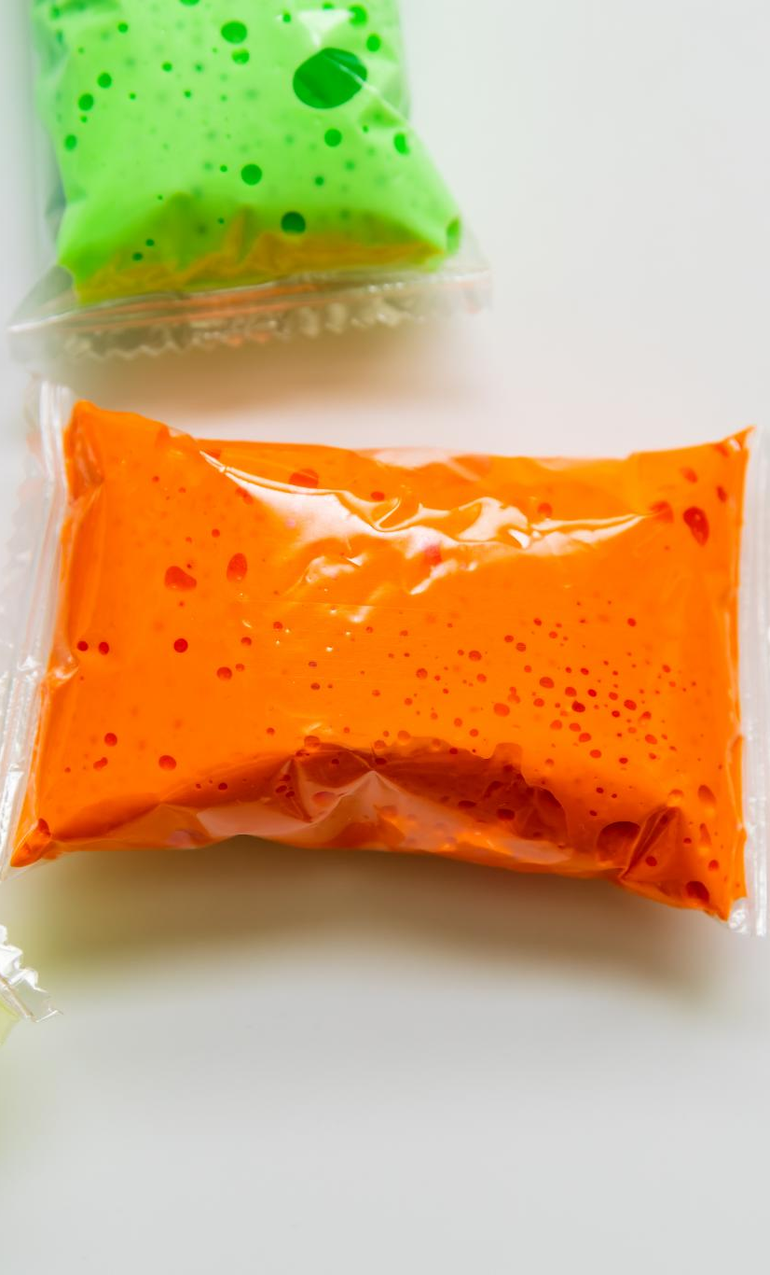
What Are Sensory Bags?
Purpose of Sensory Bags
  Sensory bags help pupils regulate alertness to achieve an optimal state for learning and engagement.
Personalization and Guidance
  Sensory bags are personalized using pupil observation and SEND professional guidance to meet individual needs.
Classroom Implementation
  In primary settings, sensory bags are kept in labeled containers or drawstring bags and used with clear expectations to support learning.
Benefits of Consistent Use
  Consistent use promotes independence, self-awareness, and emotional regulation in pupils.
Notes:
Sensory bags are small, portable collections of sensory tools that are selected to meet specific sensory and regulation needs of individual pupils or groups of pupils. They typically contain items that provide tactile, proprioceptive, or movement-based input, such as fidget toys, stress balls, putty or playdough. Sensory bags can be personalised based on observation, discussion with the pupil, and guidance from SEND professionals. Their purpose is to help pupils regulate their level of alertness so that they are in an optimal state for learning. Importantly, sensory bags are not intended to distract from learning; instead, they support the nervous system to organise sensory input so that attention and engagement can improve. In primary settings, sensory bags are often kept in labelled pouches or small containers and are introduced with clear expectations about how and when they can be used. When used consistently and appropriately, they become a supportive adjustment that promotes independence, self-awareness, and emotional regulation.

Slide 6
The Importance of Sensory Regulation
Notes:
Why Sensory Regulation Matters

Slide 7
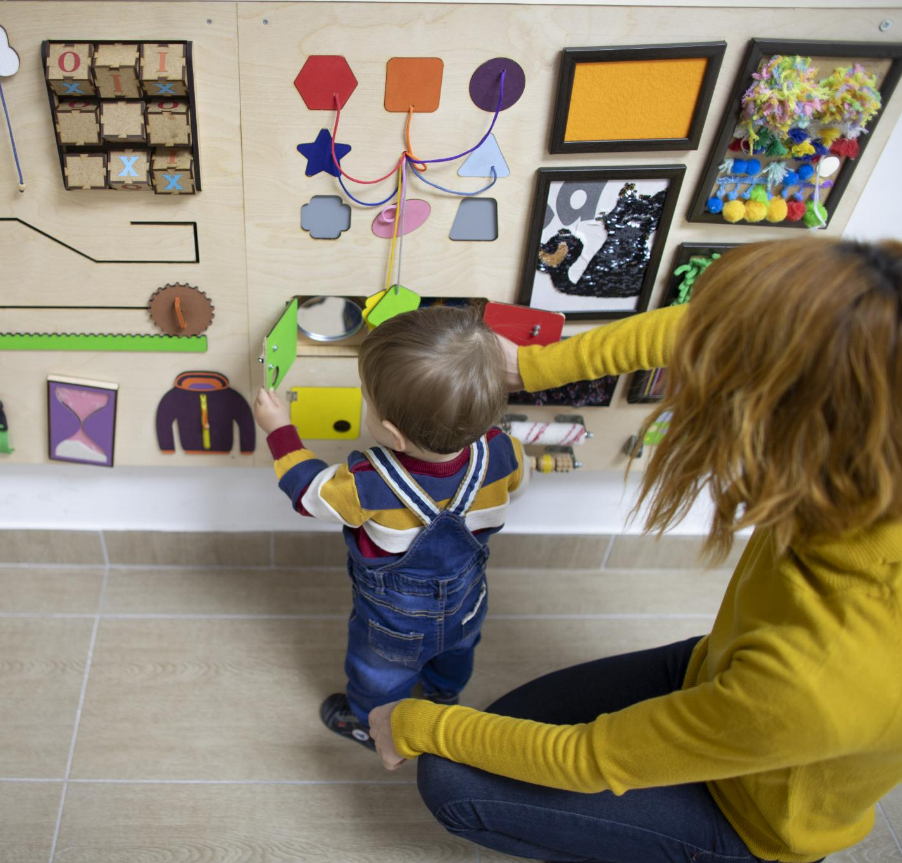
Why Sensory Regulation Matters
Sensory Processing Challenges
  Many pupils with SEND face difficulties in sensory processing and emotional regulation, impacting their learning.
Impact of Dysregulation
  Dysregulation causes stress and overload, leading to inattention, fidgeting, and challenging behaviors in pupils.
Benefits of Sensory Regulation
  Sensory regulation strategies reduce anxiety, improve wellbeing, and support positive behavior and engagement.
Inclusion and Empathy
  Understanding sensory needs promotes inclusion and encourages empathetic, proactive responses from staff.
Notes:
Many pupils in primary schools experience difficulties with sensory processing and emotional regulation, particularly those with SEND such as autism, ADHD, sensory processing differences, or social, emotional and mental health needs. When a pupil is dysregulated, their brain is focused on managing stress or sensory overload rather than learning. This can present as inattention, fidgeting, avoidance, emotional outbursts, or challenging behaviour. Sensory regulation strategies help the nervous system to feel safe, organised, and ready to learn. By meeting sensory needs, staff can reduce anxiety, improve emotional wellbeing, and support more positive behaviour and engagement. From an inclusion perspective, sensory regulation is a key part of universal and targeted provision, supporting pupils to remain in class, access the curriculum, and participate alongside their peers. Understanding the link between sensory needs and behaviour allows staff to respond with empathy and proactive strategies rather than reactive sanctions.

Slide 8
Supporting Focus and Attention
Notes:
Sensory Tools to Aid Concentration

Slide 9
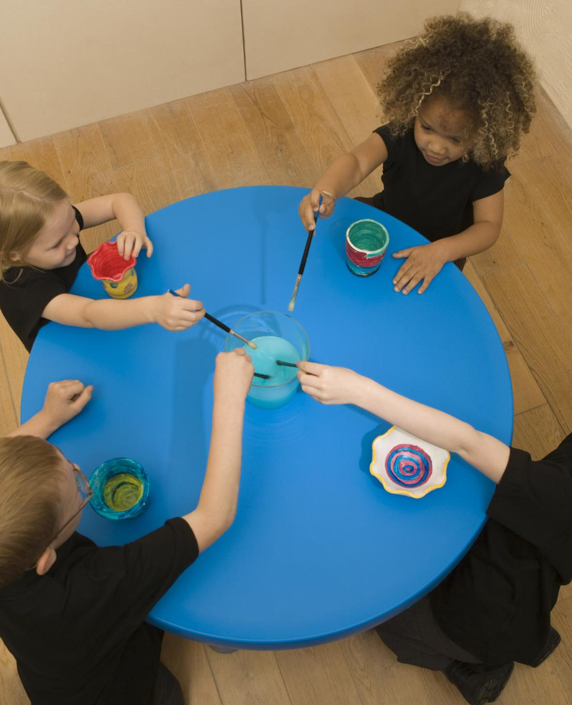
Sensory Tools to Aid Concentration
Purpose of Sensory Tools
  Sensory tools offer controlled tactile input, helping pupils focus by reducing the need for disruptive movements.
Correct Usage Guidance
  Staff should teach pupils appropriate use of sensory tools, such as keeping hands below tables and using them quietly.
Enhancing Engagement
  Sensory tools support engagement and improve concentration when combined with clear expectations and consistent routines.
Notes:
For some pupils, particularly those with attention and concentration difficulties, remaining still and focused without sensory input can be extremely challenging. Sensory tools such as fidget toys, stress balls, or putty can provide a controlled outlet for movement and tactile input, allowing the brain to focus more effectively on listening and learning. When used correctly, these tools do not distract; instead, they reduce the need for larger, disruptive movements. It is important that staff explicitly teach pupils how to use sensory tools appropriately, for example keeping hands below the table or using them quietly during input. Sensory bags should support engagement, not replace high-quality teaching strategies. When combined with clear expectations and consistent routines, sensory tools can significantly improve sustained attention, task completion, and participation for pupils who would otherwise struggle to focus.

Slide 10
Responding to Dysregulation
Notes:
Using Sensory Bags During Dysregulation

Slide 11
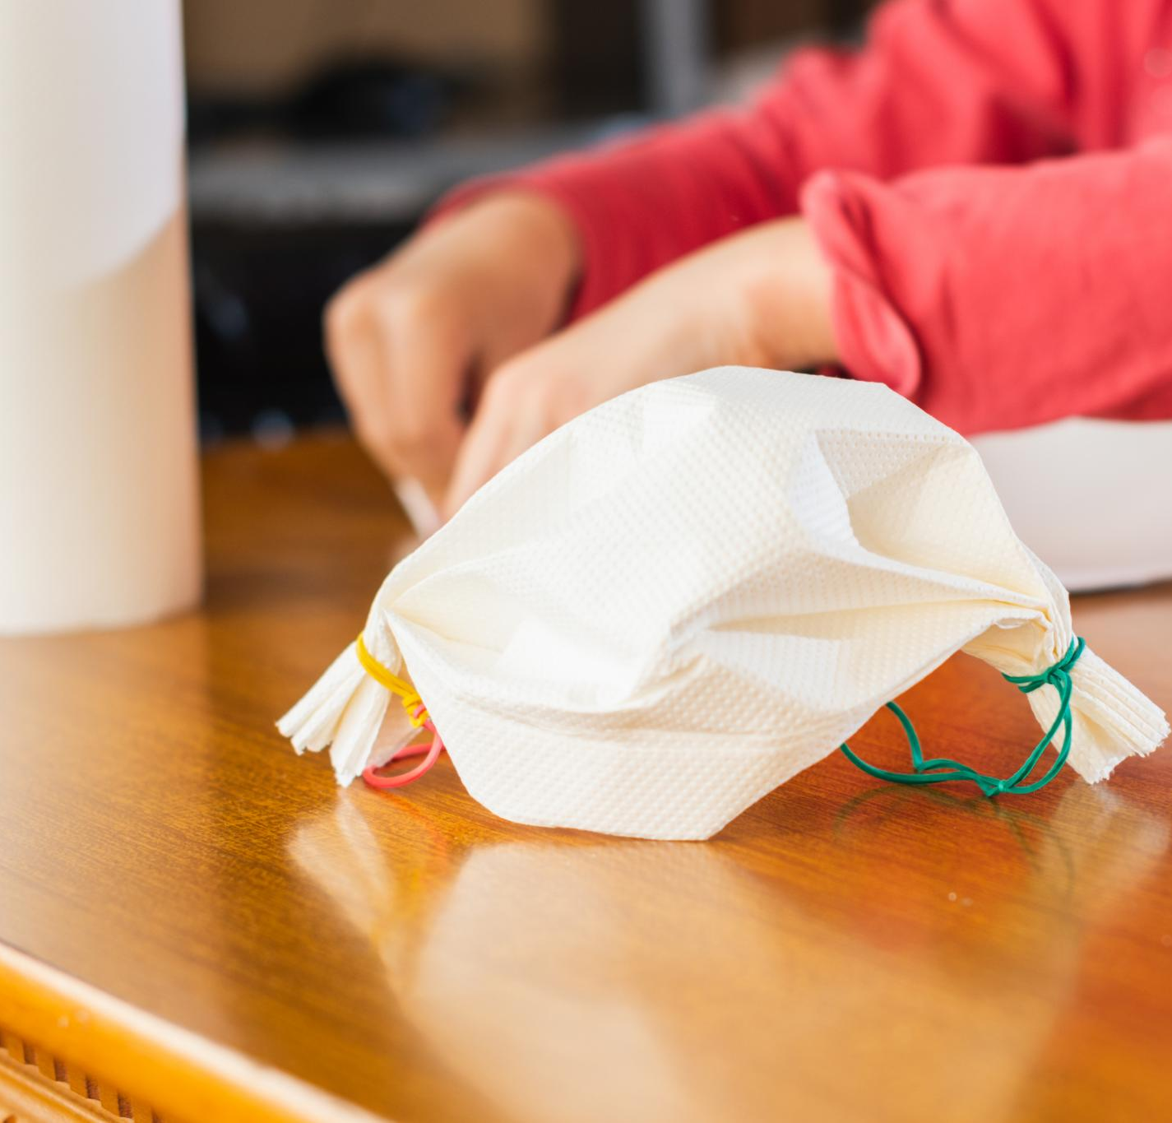
Using Sensory Bags During Dysregulation
Support During Dysregulation
  Sensory bags provide comfort and grounding during moments of sensory overload or heightened emotion.
Co-Regulation Importance
  Adults should offer sensory bags alongside co-regulation to support pupils effectively during dysregulation.
Developing Self-Regulation Skills
  With time, pupils can learn to use sensory bags independently as coping strategies for self-regulation.
Relational Emotional Support
  Sensory bags should be part of a broader relational approach, not a quick fix for behavior.
Notes:
Sensory bags can also play a valuable role in supporting pupils when dysregulation has already occurred. During moments of heightened emotion or sensory overload, pupils may find it difficult to communicate their needs or use verbal strategies. Familiar sensory tools can provide comfort, grounding, and a sense of safety, helping the pupil to calm and re-regulate. In these situations, sensory bags should be offered as part of a calm, supportive response, alongside co-regulation from an adult where needed. Over time, pupils may learn to use sensory tools independently as a coping strategy, supporting the development of self-regulation skills. It is important that staff remain attuned to the pupil’s cues and avoid using sensory bags as a way to ‘fix’ behaviour quickly; instead, they should be part of a broader, relational approach to emotional support.

Slide 12
Sensory Bag Contents
Notes:
Examples of Sensory Bag Items

Slide 13
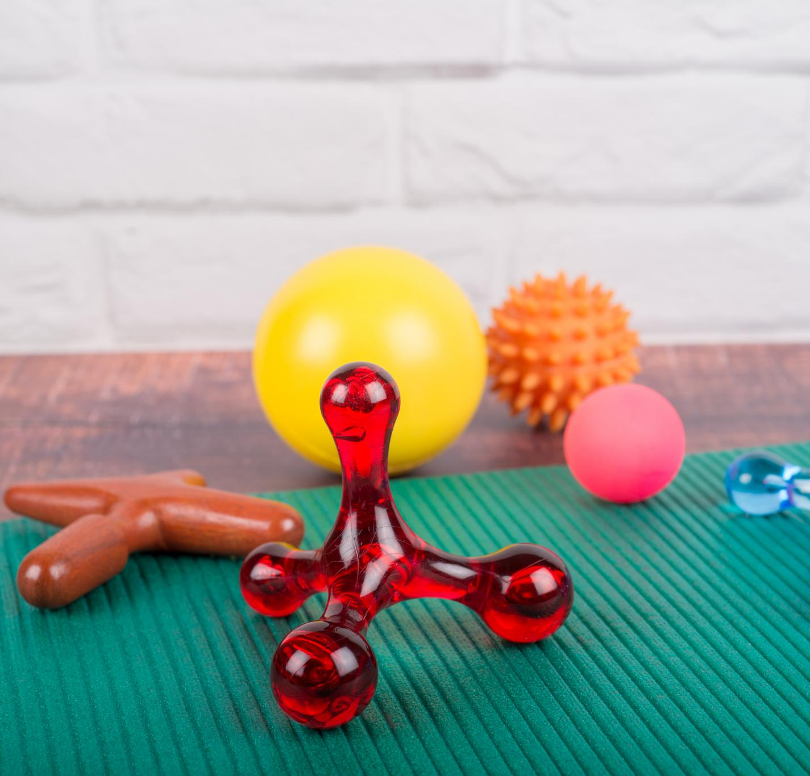
Examples of Sensory Bag Items
Fidget Toys for Tactile Input
  Fidget toys like spinners and tangles provide movement and tactile stimulation to support sensory needs.
Playdough and Therapy Putty
  Playdough and therapy putty offer resistance and calming proprioceptive feedback essential for sensory regulation.
Stress Balls and Squeeze Toys
  Stress balls and squeeze toys support emotional release and help improve hand strength.
Chew Tools and Safety
  Chew tools may be used following school policies, ensuring items are safe and appropriate for classrooms.
Notes:
Sensory bags may include a range of items, selected based on the sensory needs of the pupil. Common examples include fidget toys such as spinners or tangle toys, which provide movement and tactile input; playdough or therapy putty, which offer resistance and calming proprioceptive feedback; and stress balls or squeeze toys, which can support emotional release and hand strength. In some cases, chew tools may be appropriate, following school policies and risk assessments. It is essential that items are safe, durable, and appropriate for the classroom environment. Not all sensory tools suit all pupils, and trial and review are key. Keeping sensory bags simple and purposeful helps ensure they remain effective and manageable for both pupils and staff.

Slide 14
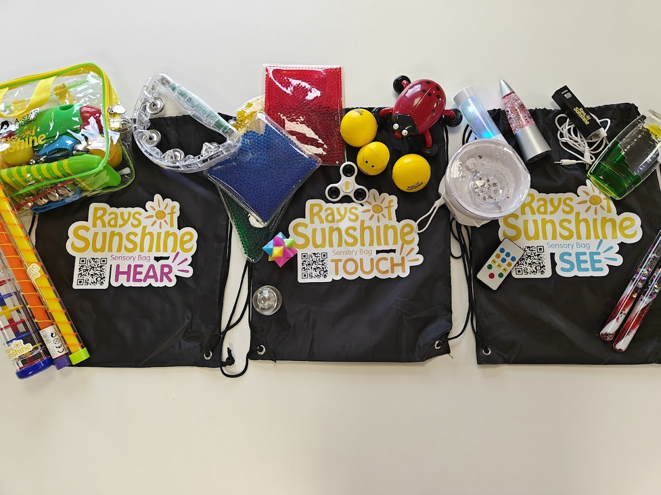
See, Hear, Touch bags
Bag for Tactile Support
Textured balls (spiky, soft, rubber)
Playdough or therapy putty
Fabric swatches (fur, velvet, rough materials)
Pop-it toys
Sensory brushes
Bead or gel-filled squish mats

Slide 15
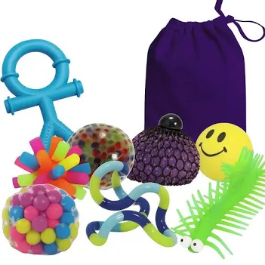
Fidget focus bags
Bag for Sensory
SupportStress balls / squishy toys
Fidget spinner or fidget cube
Chewelry (safe chewable item)
Soft fabric square or comfort item
Noise-reducing headphones
Small visual calm-down cards

Slide 16
Movement bag support
Resistance bands
Small skipping rope
Therapy putty for hand strength
Stretchy bands or loops
Mini beanbag for throwing/catching
Balance disc or wobble cushion (if space allows)

Slide 17
Implementation in the Classroom
Notes:
How and When to Use Sensory Bags

Slide 18
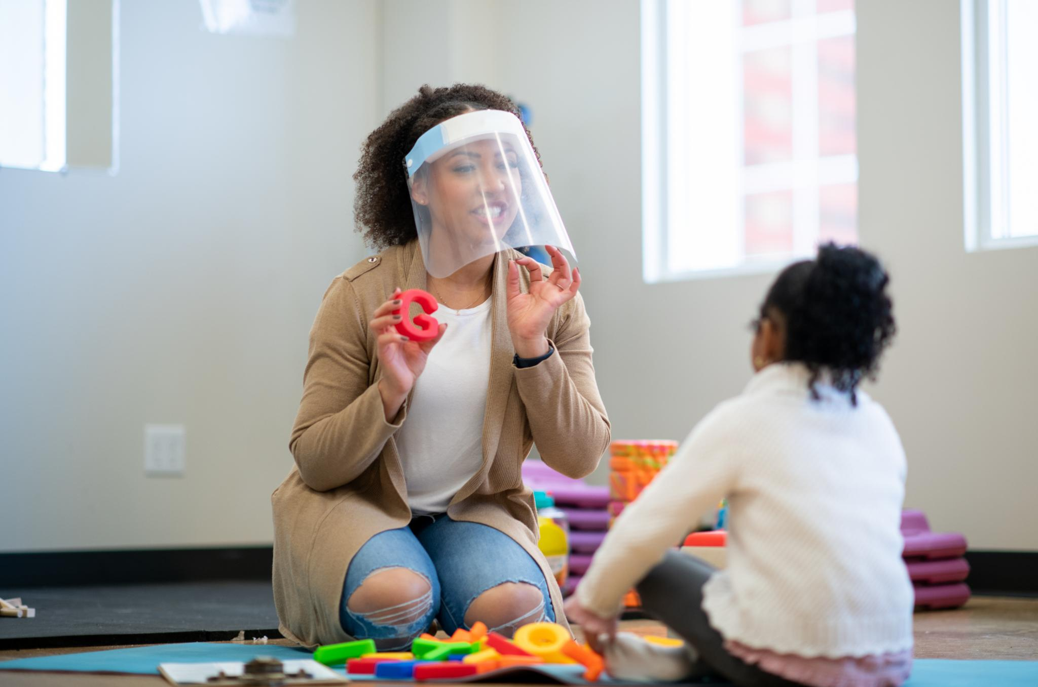
How and When to Use Sensory Bags
Clear Routines and Boundaries
  Successful sensory bag use depends on clear routines, boundaries, and shared understanding among educators.
Explicit Introduction and Modeling
  Sensory bags should be introduced explicitly with demonstrations and explanations of their purpose to students.
Targeted Usage During Activities
  Use sensory bags during specific times like listening sessions, independent work, or transitions based on individual needs.
Consistency and Regular Review
  Consistent use by staff and regular review ensures sensory bags support learning and regulation effectively.
Notes:
Effective implementation of sensory bags relies on clear routines, boundaries, and shared understanding among staff. Sensory bags should be introduced explicitly, with time taken to model appropriate use and explain their purpose to pupils. They can be used during specific activities such as listening on the carpet, independent work, or transitions, depending on individual need. Consistency across staff is essential to avoid confusion or overuse. Sensory bags should be reviewed regularly to ensure they are having a positive impact on learning and regulation. When embedded as part of everyday classroom practice, sensory bags become a normalised and inclusive support rather than something that sets pupils apart.

Slide 19
SEND and Individualisation
Notes:
Individualisation and SEND Support

Slide 20

Individualisation and SEND Support
Individualised Sensory Support
  Sensory bags should be tailored to each pupil’s unique needs identified through assessment and family-professional collaboration.
Graduated SEND Provision
  Sensory bags fit within universal, targeted, or specialist SEND support, adapting to different levels of pupil needs.
Inclusion and Access
  Sensory bags are practical reasonable adjustments that improve inclusion and access to learning for SEND pupils.
Monitoring and Evidence
  Recording sensory bag use and impact helps provide evidence for support plans and reviews.
Notes:
Sensory bags are most effective when they are individualised and linked to a pupil’s specific needs, as identified through observation, assessment, and discussion with families and professionals. What is calming for one pupil may be alerting or distracting for another, so ongoing review is essential. Sensory bags can form part of a graduated approach to SEND support, sitting within universal, targeted, or specialist provision as appropriate. For SENDCOs, sensory bags offer a practical example of reasonable adjustments that support inclusion and access to learning. Recording their use and impact can also contribute to evidence for support plans and reviews.

Slide 21
Conclusion
Notes:
Key Takeaways for Staff

Slide 22
Key Takeaways for Staff
Support Regulation and Focus
Sensory bags help pupils regulate emotions and improve attention proactively and thoughtfully.
Inclusive Child-Centred Approach
Sensory bags embody an inclusive strategy linking sensory needs with learning for SENDCOs and teachers.
Creating Supportive Environments
Embedding sensory strategies fosters calmer classrooms enabling pupils to succeed better.
Notes:
Sensory bags are a simple yet powerful tool for supporting regulation, focus, and emotional wellbeing in primary school settings. When used proactively and thoughtfully, they can prevent dysregulation, improve attention, and help pupils to re-regulate when difficulties arise. For SENDCOs and teachers, sensory bags represent an inclusive, child-centred approach that recognises the link between sensory needs and learning. By embedding sensory strategies into everyday practice, schools can create calmer, more supportive learning environments where all pupils are better able to succeed.

